Slide 1




IT Strategic Plans for New Technology: Industry: Finance and Insurance Industry
Authors:
VAISHNAVI CHAKRADEO
Jacob Foster
Sri SAI KOWSHIK REDDY Boyalla
ABHISHEK SUBRAMANIAM

Slide 2
Reinforcement Learning
Reinforcement learning is a technique of machine learning used to maximize reward in a situation
The RL algorithms learn from their outcomes
It is an autonomous self-teaching system
Two types of reinforcement: Positive reinforcement, negative reinforcement

Slide 3
IT initiatives using RL
Pricing Strategy Optimization
Stock Trading optimization
Credit risk prediction
Portfolio Optimization

Slide 4
Associated Risks
Initiative | Associated Risk
Pricing Strategy Optimization | Model Overfitting Non-compliance to pricing regulations Resistance from employees to shift from traditional methods of pricing.
Stock Trading Optimization | Inaccurate results might lead to financial losses for traders Market manipulation risk
Credit Risk Prediction | The risk of getting inaccurate predictions can lead to unfair lending of money. Risk of model overfitting
Portfolio Optimization | Model inaccuracies can result in financial losses from poor investment decisions

Slide 5
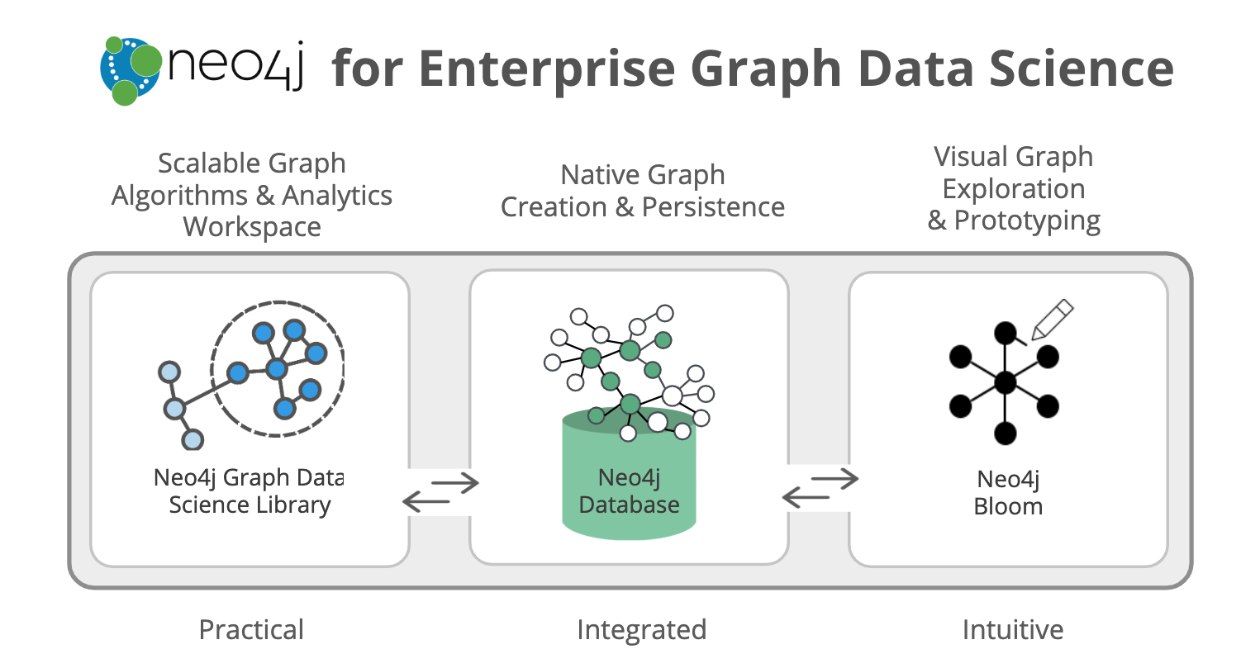
Introduction to Graph Data Science
Graph Data Science is an analytics and machine learning (ML) solution that analyzes relationships in data to improve predictions and discover insights. It plugs into data ecosystems so data science teams can get more projects into production and share business insights quickly.(https://neo4j.com/product/graph-data-science/)

Slide 6
Information Technology Objectives
To help upgrade the cyber-security norms of the finance and insurance industry.
To improve the labor markets and consumer behavior.
To ensure regulatory compliance in order to avoid hefty fines.
To educate and empower

Slide 7
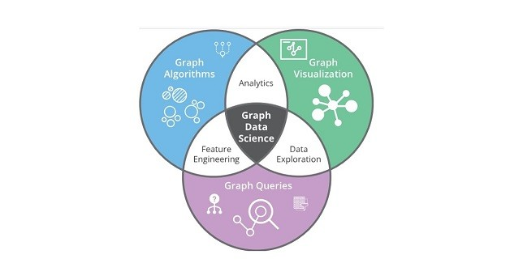
Information Technology Initiatives
Fraud Detection Strategy
Regulatory Compliance Databases
Risk Assessment and Prediction
Gamified/Knowledge Based Applications

Slide 8
Associated Risks
Initiative | Associated Risk
Fraud Detection Strategy | The graph neural network is extremely complex to set up which requires heavy computing. Inaccurate results due to ineffective parameter setting. High set-up cost with long pay off time.
Regulatory Compliance Databases | Studying the regulation and remodeling the data can lead to be very complex. Ineffective Knowledge Transfers can lead to poor usage of resources. Ineffective GNN Models will lead to poor regulatory control, leading to heavy losses in terms of fines.
Risk Assessment and Prediction | The risk of getting inaccurate predictions can lead to unfair lending of money. Risk of model overfitting Inaccurate Risk Assessment Score calculations can lead to ineffective models. Ineffective Knowledge Transfers can lead to poor usage of resources.
Gamified/Knowledge Based Applications | Creating a space for a new application in the current market scenario may be tough. Since the application will be directly being released by a financial institution, the regulatory compliance risk is an impending one. Score Creep

Slide 9
Federated Machine Learning
Federated Machine Learning (FML) is a decentralized approach where model training occurs on local devices or servers holding data samples.
Each device trains a local model on its data, periodically sending updates to a central server.
The server aggregates these updates to create a global model, which is then sent back to the devices for further training.
FML offers privacy preservation, reducing communication overhead, scalability, and decentralized control.

Slide 10
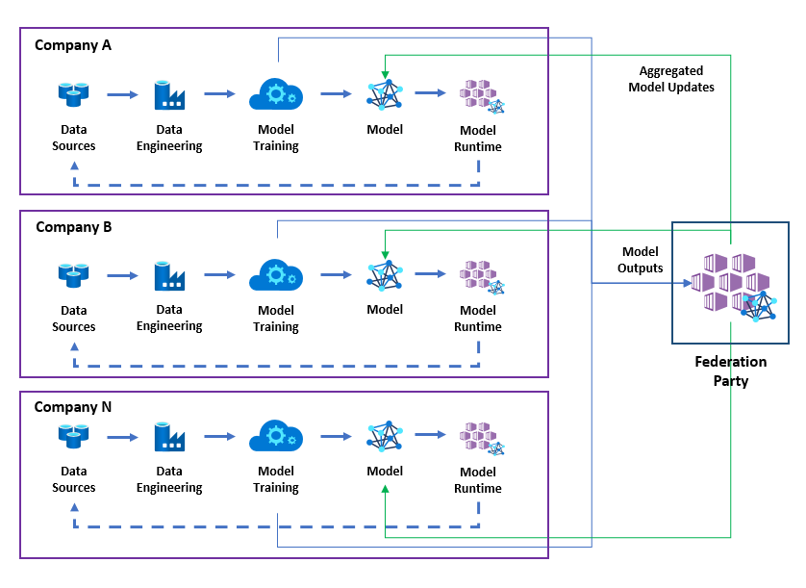
General FML Model

Slide 11
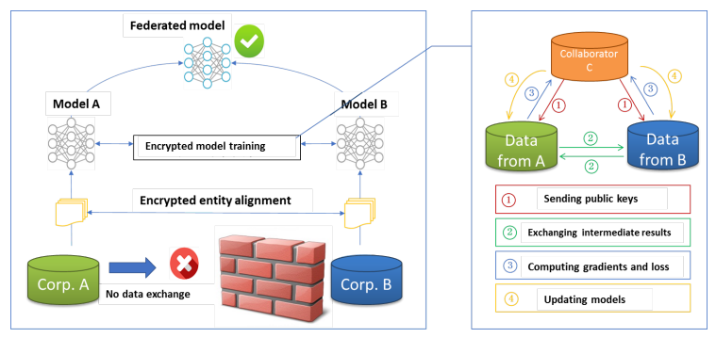
FML Model In Finance and Insurance Industry

Slide 12
IT Objectives
To safeguard financial assets from fraudulent activities, enhance brand reputation, and ensure competitiveness in the market.
To enhance customer satisfaction with relevant suggestions, drive revenue generation, and cultivate long-term customer relationships for sustained profitability.
To improve risk management practices, reduce claim losses, and ensure compliance with regulatory standards, thereby maintaining market competitiveness and profitability.

Slide 13
IT Initiatives using FML
Fraud Detection using FML such as – Credit Card fraud, E-banking fraud account Identification.
Personalized Financial Recommendations - Personalized advice on savings, insurance coverage, investments etc. using FLRM.
Risk Assessment Enhancement - Financial, Underwriting, Claims risks assessment and tailor coverage options using FML.

Slide 14
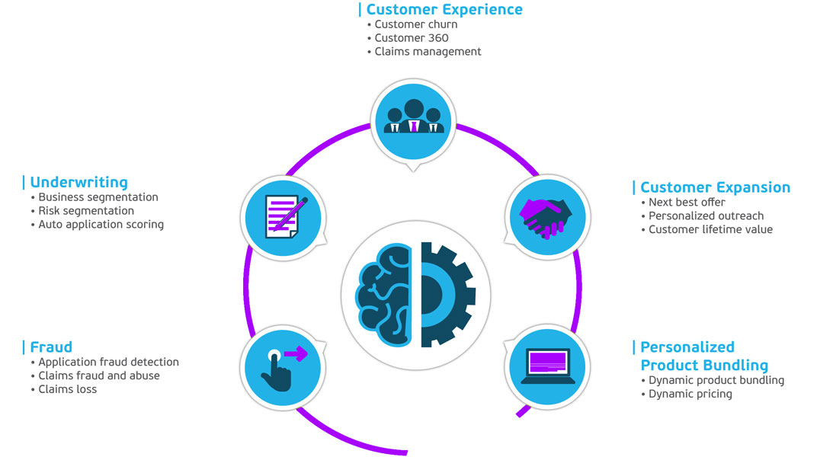
Advantages of Using FML

Slide 15
Associated Risks
Initiative | Associated Risk
Fraud Detection | Algorithm Accuracy – Ensuring new models effectively identify fraudulent activities. Data Security - Protecting sensitive financial information during data gathering and analysis. Regulatory Compliance – Adhering to financial regulations to avoid legal implications
Personalized Financial Recommendations | Algorithm Accuracy – Ensuring personalized recommendations align with user financial goals and preferences. User Privacy – Balancing personalized recommendations with user privacy concerns. Technical Challenges – Potential disruptions during algorithm implementation and system upgrades.
Risk Assessment Enhancement | Data Quality Risks – Ensuring accurate and reliable data integration from diverse sources. Model Accuracy Risks – Ensuring machine learning algorithms provide accurate risk assessments Implementation Risks – Potential challenges during system integration and deployments

Slide 16
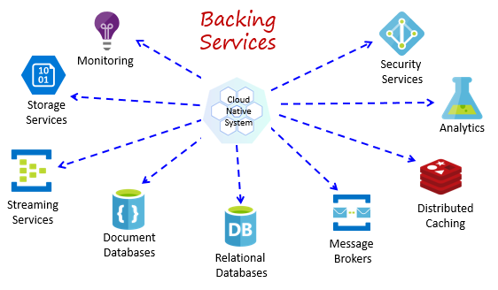
Cloud Native Computing
Cloud Native refers to tactics utilized to build, deploy, and run software on cloud stacks.
Modern companies want to build highly scalable, flexible, and resilient applications that they can update quickly to meet customer demands.

Slide 17
IT Initiatives using Cloud Native Computing
Incorporation of Managed Services
Improved Regulatory Compliance
Cloud Scalability and Elasticity

Slide 18
Associated Risks
Initiative | Associated Risk
Managed Services | Organizations may become over reliant on cloud services for critical business operations – which could open them up to risk in the event a disruption to the service occurs. Security and privacy risks may arise as now there are external parties who are involved in the handling of sensitive financial as well as personal data.
Improved Regulatory Compliance | New laws require cloud services to stay keen and up to date on any newly passed regulation or legal changes. Industry specific standards may cause steep learning curves for compliance aiding platforms.
Scalability and Elasticity | Vendor lock in can limit flexibility and induce high switching costs in the event a new platform is desired. If done improperly, poor scaling mechanisms can lead to performance degradation as the load on the system spikes.

Slide 19
Thank You

